Slide 1
About myself- a walk into my life
Presented by:
Amna Khan
ERP:
24085

Slide 2
An introduction
My name is Amna Khan and I did my schooling from St. Joseph’s Convent High School and then my Intermediate from St. Lawrence’s College.
I am currently studying at the IBA and have taken up BBA as my degree.
I have two sisters and I am the middle child, always stuck between, ‘she’s elder than you, you should listen to her’ and ‘she’s younger than you, you should take care of her.’

Slide 3
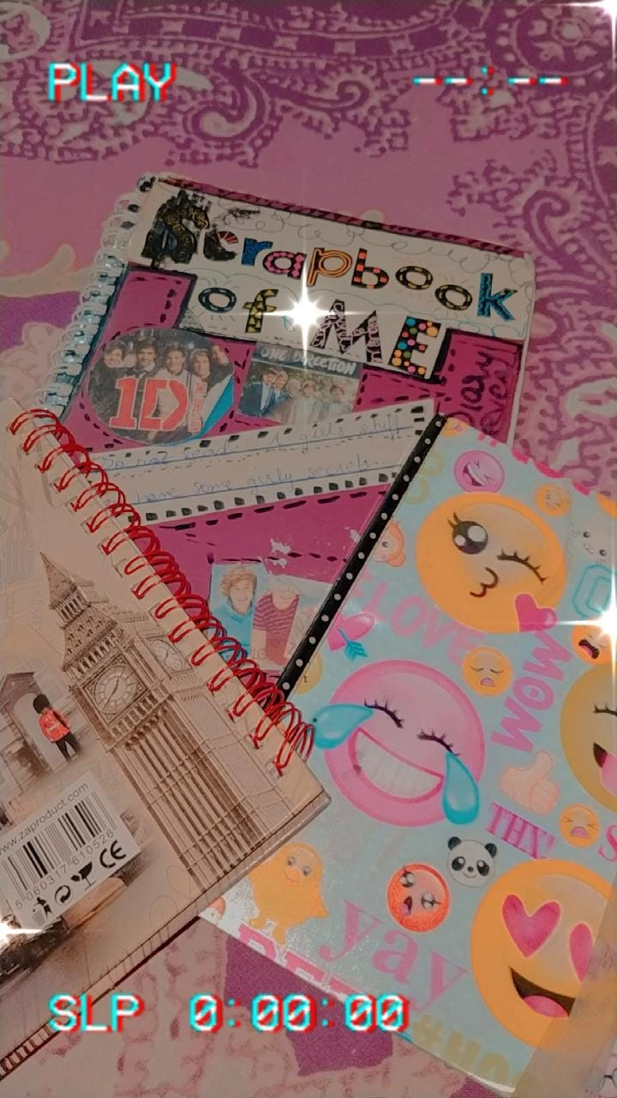
My childhood
I was a very mischievous child, I liked to run around and mess up with things, I loved to paint and listen to music all the time.
I used to go for cycling along with my grandfather and cousins, it was the most memorable time.
I used to write in my diary everyday, I still have those journals with me.
I was also a crazy follower of a musical band called “One Direction”.
A shot of my journals.

Slide 4
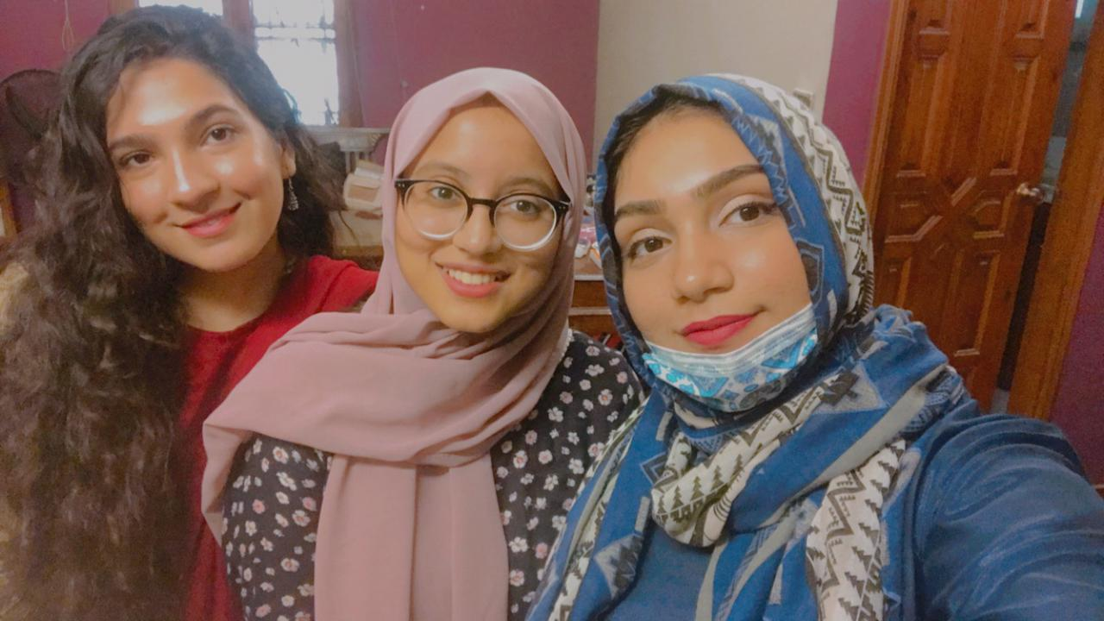
My teen years
I spent most of my teenage being the most popular girl in school.
I excelled in all the extra-curricular activities and managed my academics perfectly alongside.
I was a really fun loving individual and was always the life of a party.
I had a lot of friends and luckily, they still are a part of my life.
A picture of me and my childhood bestfriends.

Slide 5
Current life
Now I am an 18 year old, going to university and currently in my freshman year at the IBA.
Things sort of have changed ever since I have joined university, I had the same friends in school and in college but unfortunately, we all went to different universities and now I miss them a lot.
I made really good friends here too, and I have seen a change in my personality now as I have turned more of an ambivert.

Slide 6
Current life
I used to be a complete extrovert back then but now I am more of an omnivert, I socialize according to my mood and I guess my social anxiety has increased over the years.
I am always spending more time on my self growth now.
I aspire to be an individual that I myself am proud of.
I have goals and ambitions related to my career and my personal growth.

Slide 7
MY ambitions
I want to be a makeup artist and I want to open up my own studio as an entrepreneur.
With the benefit of being really good at art, I have always found human faces as the perfect canvas to produce magic on.
Some find their therapy in music, some find it in other people, but I find therapy in makeup.
It gives me the perfect opportunity to focus on my creative side and makes me happy at the same time. So for me, pursuing this as a career is a perfect example of ‘doing what you love’ and making money out of it as well.

Slide 8
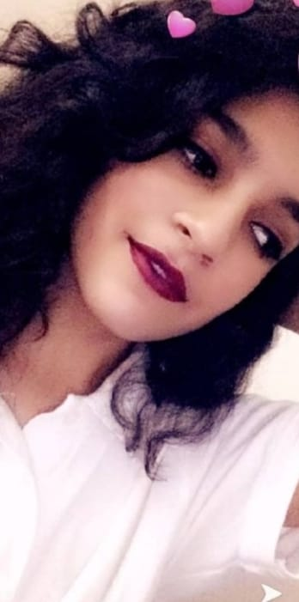
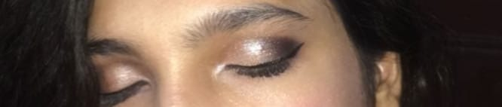
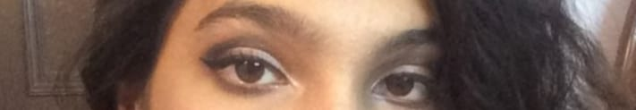
some of my makeup looks
There has been progress of my makeup looks over the years.
Below are some of the looks I have created till date.
A look I created in 2019
A look I created in 2018

Slide 9
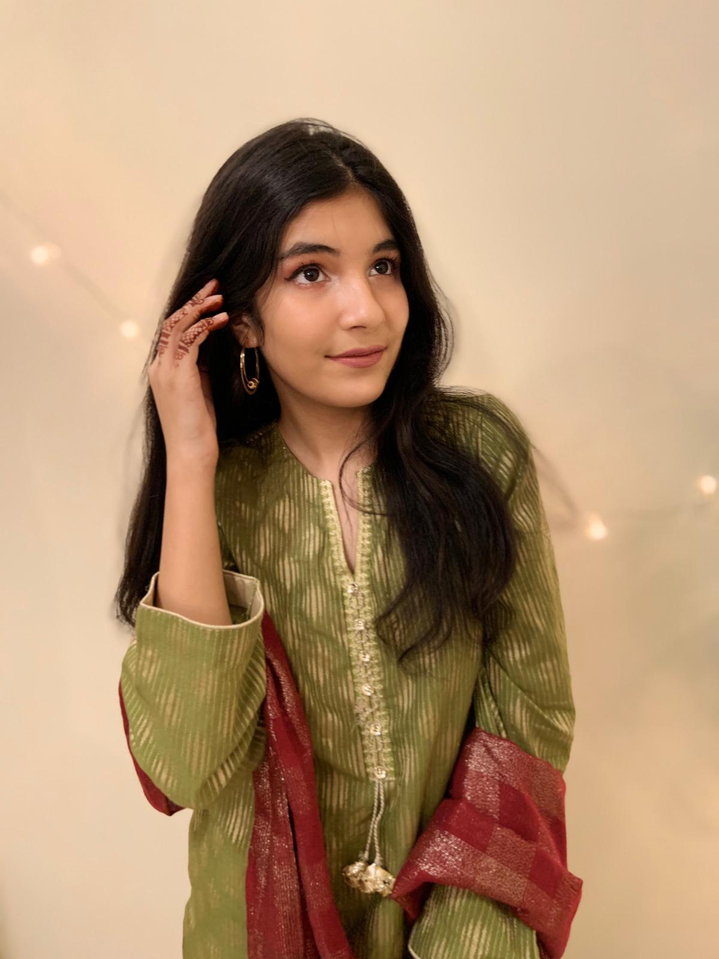
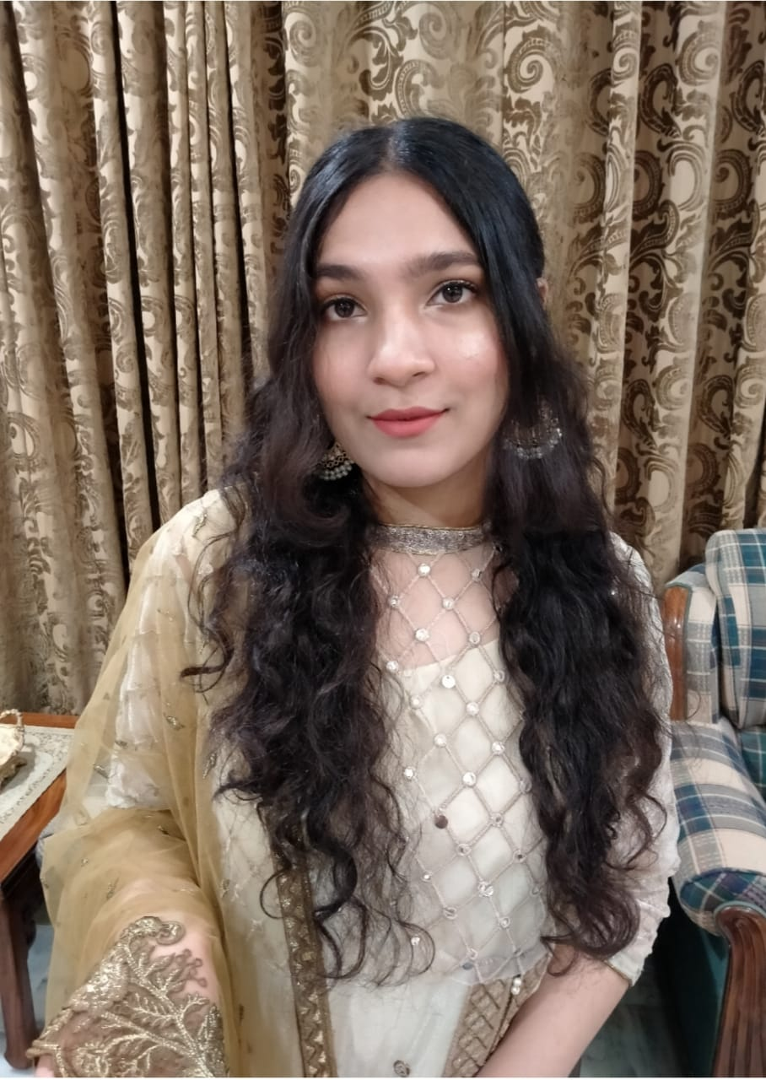
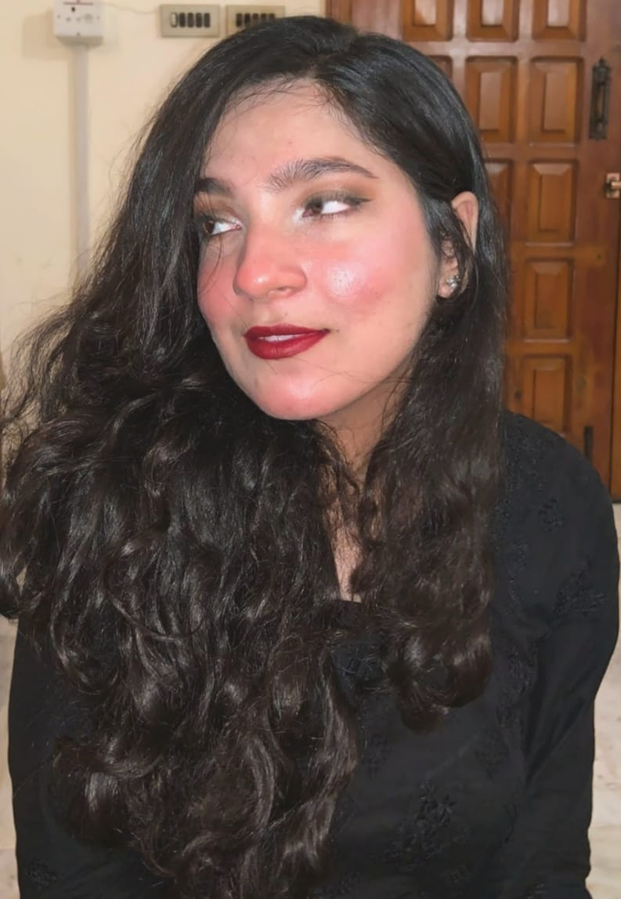
Progress in my makeup looks
This is the progress I have made till date.
Created these looks on myself and my sister in 2021

Slide 10
conclusion
Thankyou for giving me the chance to take a walk down this beautiful memory lane.
I am really proud of where I stand and what I do today and I really hope to aspire all my dreams, one step at a time.
And I hope that this journey of my life, put a smile to your face.

